Slide 1
Introduction
Chaklam Silpasuwanchai

Slide 2
Readings
Chapter 1-2, Foundations and Getting Started, Cormen et al. (2009). Introduction to Algorithms, Third Edition (3rd ed.). The MIT Press.
Chapter 2, Introduction to Algorithm Design, Skiena, S. S. (2008). The Algorithm Design Manual, Second Edition (2nd ed.). Springer Science & Business Media.

Slide 3
Outline
Role of algorithms in computing
Getting started
Insertion sort
Merge sort

Slide 4
Role of algorithms in computing

Slide 5
Algorithms
Algorithm is any well-defined computational procedure that takes some value as input and produces some value as output.
E.g., sort a sequence of numbers into non-decreasing order
Input: A sequence of n numbers <a₁, a₂, …., a_{n}>
Output: A permutation (reordering) <a*₁, a*₂, …., a*_{n}> such that a*₁ ≤ a*₂ ≤ …. ≤ a*_{n}
For example, given the input sequence <31, 41, 59, 26, 41, 58>, a sorting algorithm outputs <26, 31, 41, 41, 58, 59>. The input sequence is also called an instance of the sorting problem
Algorithm -> solutions to computer science problems

Slide 6


Algorithms as difference maker
Suppose a faster computer A running insertion sort compared with slower computer B running merge sort
Suppose A executes 10 billion instructions per second, and B executes 10 million instructions per second. A 1000 times difference
Suppose input is 10 million numbers. The best programmer implemented a insertion sort algorithm that requires only 2n². An average programmer implemented a merge sort algorithm that requires 50 n log n. To sort the given input, A and B take
A)
B)

Slide 7
Example
CLRS 1.2-2 Suppose we are comparing implementations of insertion sort and merge sort on the same machine. For inputs of size n, insertion sort runs in 8n², while merge sort runs in 64 n log n steps. For which values of n does insertion sort beat merge sort?
Notes:
8n^2<=64nlogn n^2<=8nlogn n<=8logn
n-8logn = 0
n = 43.411
n<=43

Slide 8
Example
CLRS 1.2-2 Suppose we are comparing implementations of insertion sort and merge sort on the same machine. For inputs of size n, insertion sort runs in 8n², while merge sort runs in 64 n log n steps. For which values of n does insertion sort beat merge sort?
8n² ≤ 64 n log n
n² ≤ 8 n log n
n ≤ 8 log n
n - 8 log n = 0
n = 43.411
n ≤ 43
Notes:
8n^2<=64nlogn n^2<=8nlogn n<=8logn
n-8logn = 0
n = 43.411
n<=43

Slide 9
Insertion sort

Slide 10
Insertion sort
Insertion sort solves the sorting problem:
Input: A sequence of n numbers <a₁, a₂, …., a_{n}>
Output: A permutation (reordering) <a*₁, a*₂, …., a*_{n}> such that a*₁ ≤ a*₂ ≤ …. ≤ a*_{n}
The numbers we wish to sort are also called keys
Insertion sort is an efficient algorithm for sorting a small number of elements.

Slide 11
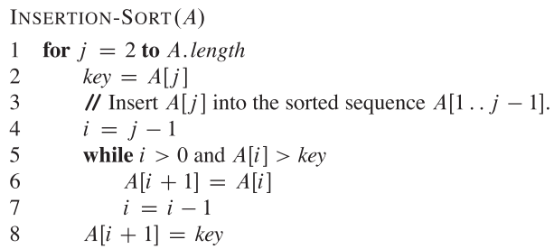
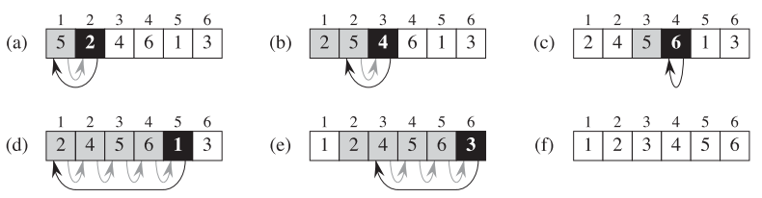
Insertion sort
set key as A[2] value
set i for comparison
while i is bigger than key
put i with i+1 values
move i one step back for comparison
set the key as front of i

Slide 12
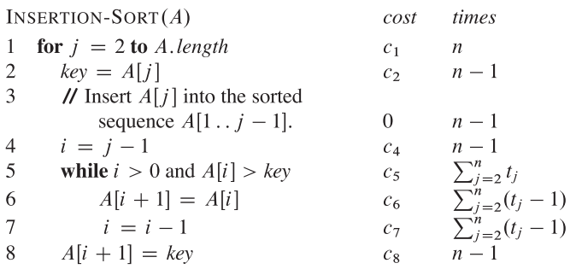
Analysis of insertion sort
For each j = 2, 3, ….n, where n = A. length, we let t_{j} denote the number of time the while loop test in line 5 is executed for that value of j
Running time of algorithm is the sum of running times for each statement; a statement that take c_{i} steps to execute and executes n times will contribute c_{i}n to the total running time
why n?

Slide 13
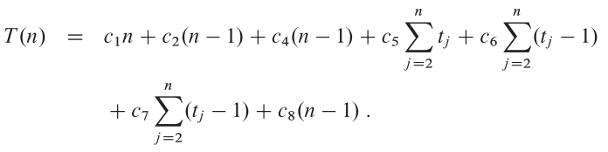
Analysis of insertion sort
why n?
Notes:
because the last loop needs to check but return false

Slide 14

Analysis of insertion sort
For best case, it occurs when the array is already sorted. We will then find that A[i] ≤ key in line 5. Thus t_{j} = 1 for j = 2, 3, …..n, and the best running time is
We can say that the running time is an+b, i.e., a linear function of n that depend on c_{i}

Slide 15


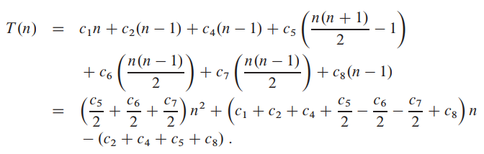
Analysis of insertion sort
For worst case, it occurs when the array is in reversed sorted order. We must compare A[j] with each element. Thus
The running time is
How? Try to make a proof this is true.
We can say that the running time is a an²+bn + c, i.e., a quadratic function of n that depend on c_{i}
Notes:
S = 1 + 2 +....(n-1) + n
S = n + (n-1) ….. + 2 + 1
2S = n+1 + n+1 + n+1
2S = n(n+1)
S = n(n+1)/S

Slide 16
Insertion sort - Pros and Cons
Pros | Cons
Really good for small dataset (n² is still acceptable) and if the list is partially sorted (O(n)) Very memory efficient because you don’t need to allocate any new memory space (O(1)) | Really bad for big dataset (n²) is time-consuming In big dataset, mergesort and quicksort could be much better option

Slide 17
Exercises
CLRS 2.1-1 Illustrate the operation of Insertion sort on the array A = <31, 41, 59, 26, 41, 58>
Notes:
A[i] < key

Slide 18
Merge Sort

Slide 19
Merge Sort
Merge sort algorithm follows a recursive procedure MERGE (A, p, q, r) where A is an array and p, q, and r are indices into the array such that p ≤ q < r. The procedure assumes that the subarrays A[p….q] and A[q + 1….r] are in sorted order. It then merges them to form a single sorted subarray A[p...r]
Each MERGE procedure takes time 𝚯 (n) where n = r - p + 1
Notes:
Both are theta of n

Slide 20
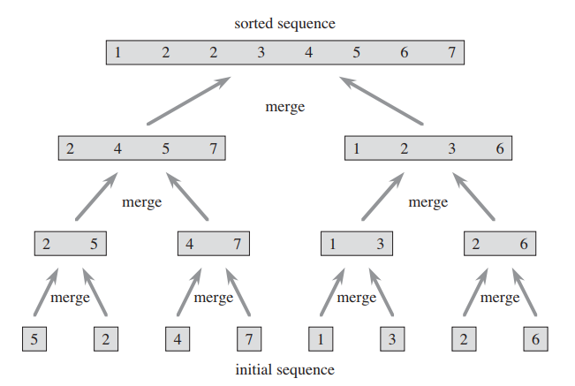
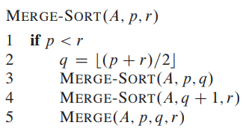
Merge Sort
p =1
q = 4
r = 8
5 | 2 | 4 | 7 | 1 | 3 | 2 | 6
Notes:
Both are theta of n

Slide 21
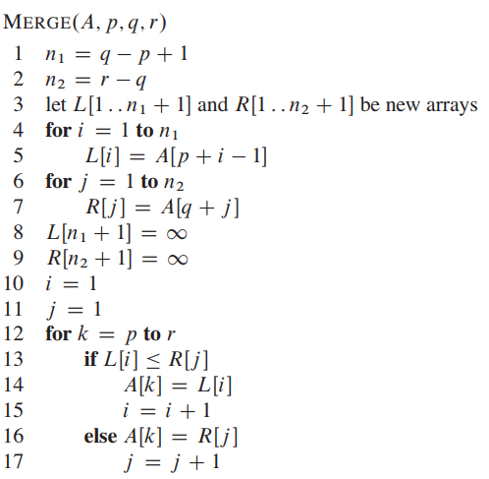
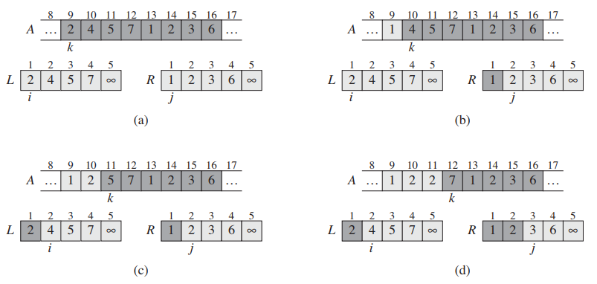
Merge
// Computes the length of subarray
// Create Left Right arrays. The extra position hold an infinity value that informs the nil value
//Copy A to Left and Right arrays
// Set the last value as infinity that informs the nil value, which helps in merging
Explains line 10 - 17
Notes:
Both are theta of n

Slide 22
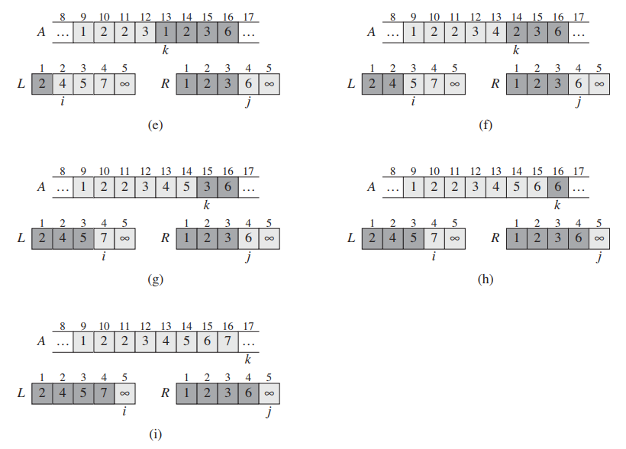
Merge
When j meets the infinity, copies everything from i , i+1, i+2 …. until it meets the infinity
Notes:
Both are theta of n

Slide 23
Merge
To prove that the worst running time is n, we can simply scan the lines where it takes the most time which are the for loops
Here, lines 4-7 take 4n = 𝚯(n)
Similarly, line 12 take 𝚯(n)
So in total, 𝚯(n) + 𝚯(n) = 𝚯(n)
Notes:
Both are theta of n

Slide 24
Analysis of merge sort - performance
The complexity depends on three steps
The step that it divides (computing middles takes constant)
O(1)
The step that it combine (comparison
O(n)
The number of times that it does divides and combine recursively
O(log n)
Thus the complexity is in total O(n log n) (applies to best, average, worst case no matter what)

Slide 25
Analysis of merge sort - space
O(n) because every time it merges, it needs to first create a empty array to store stuff so you can compare and copy.
Btw, what is the space complexity of insertion sort?

Slide 26
Merge sort - Pros and Cons
Pros | Cons
Worst case is still O(n log n) Can exploit parallel computing | A bit slower than quicksort (but not in worst case of quicksort) It needs to take more memory space (n) since it needs to allocate space proportionately to n entries (everything it splits and merges)

Slide 27
Exercises
CLRS 2.3-1 Illustrate the operation of merge sort on the array A = <3,41,52,26,38,57,9,49>
Notes:
A[i] < key

Slide 28
Assignment
Implement insertion and merge sort
Convert pseudo code to real python code
Submit in google classroom before next week
Copying from internet or friends will receive 0 marks

